Slide 1
Cognitive training in an everyday-like virtual reality enhances visual-spatial memory capacities in stroke survivors with visual field defects
Topics in Stroke Rehabilitation 2020
Impact Factor: 3.407

Slide 2
Introduction
1. In less than 10 percent of stroke patients, one quadrant of the visual field is affected (quadrantanopia, 象限盲).
2. Stroke patients with hemianopia (偏盲) and quadrantanopia also exhibit pronounced deficits in cognitive tasks that require intact visual or spatial processing such as visual scanning or visual memory.
3. There is a lack of therapeutical options for patients with hemianopia or quadrantanopia, so that new innovative approaches are urgently needed.
4. We examined the possible benefits of VR training for stroke survivors with visual field defects due to hemi- or quadrantanopia on the positive effects of VR training on cognitive functioning.

Slide 3
Methods
1. Participants
(1) 20 stroke patients with hemi- or quadrantanopia and 20 healthy controls
(2) Inclusion criteria
(a) Diagnosis of hemianopia or quadrantanopia after stroke
(b) Age ≥18 years
(c) Good knowledge of the German language
(d) IQ ≥85
(e) Stroke incidence within the last 6 months
(f) Infarction in the territories of the medial and posterior (后部) cerebral arteries as being indicated by MRI. Only lesions in these parts of the brain usually result in hem hemianopia and quadrantanopia.

Slide 4
Methods
1. Participants
(3) Exclusion criteria
(a) Neglect, claustrophobia (幽闭恐惧症), aphasia (失语症) or other language disabilities.
(b) Severe psychiatric (精神病学) or other medical comorbidities (并发症).

Slide 5
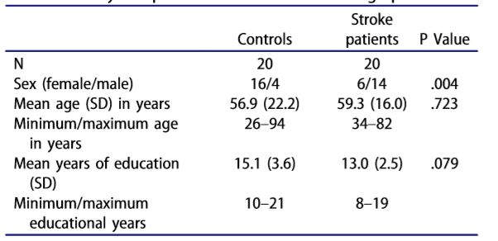
1. Eighteen of the 20 patients were diagnosed with hemianopia; two patients were diagnosed with quadrantanopia.
2. Stroke was ischemic in 18 patients, hemorrhagic in one case, and combined ischemic and hemorrhagic in another one.
3. In nine patients, stroke was right sided, and left-sided in 11 patients.

Slide 6
Materials and Methods
2. VR
(1) VR device:
(a) the OctaVis
(b) A swivel chair
(c) A “throttle joystick”
(2) Virtual environment
(a) Medium-sized supermarket (25 m × 25 m)
(b) More than 50,000 different products

Slide 7
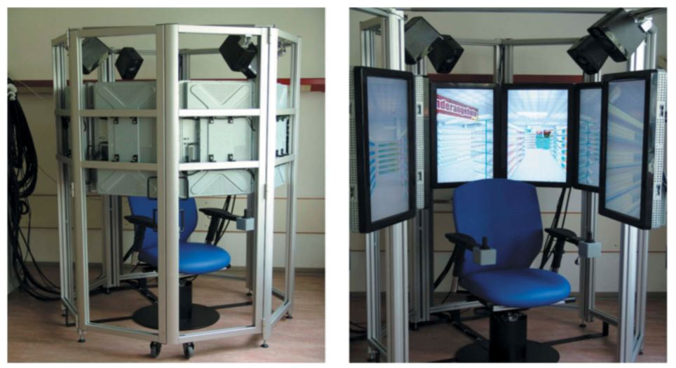

Slide 8
Materials and Methods
2. VR
(3) Training program
(a) Learn a same shopping list (auditorily presented) and to subsequently buy the respective products of this shopping list in a VR supermarket.
(b) Six sessions involving both learning and supermarket tasks (sessions 1–6).
(c) In two additional sessions, the supermarket task was accomplished with presenting a distractor list before (session 7) and without presenting a list before (session 8).

Slide 9
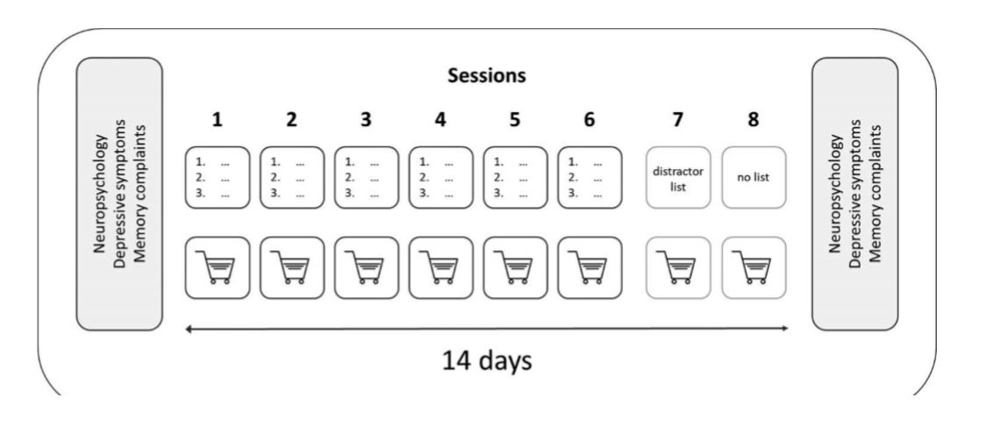

Slide 10
Materials and Methods
3. Outcome Measurements
(1) Correctly bought products, the shopping time (in seconds) and the covered distance (in meters).
(2) 30-min ReyOsterrieth Complex-Figure (ROCF) for visuoconstruction.

Slide 11
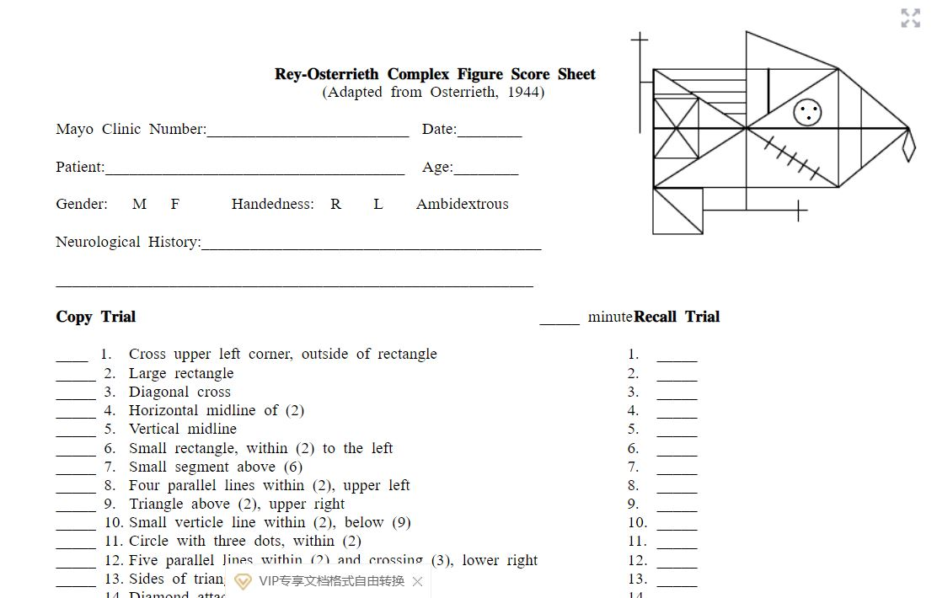

Slide 12
Materials and Methods
3. Outcome Measurements
(3) Taylor Complex Figure Test (TCFT) for visuoconstruction.
(4) Test of Attentional Performance (TAP) for attentional functions as alertness and visual scanning: To press a button as quickly as possible in reaction to a cross on the monitor.
(5) Digit Span task [forward and backward] of Wechsler Memory Scale-Revised (WMS-R) for verbal short term and working memory.
(6) Corsi blocktapping test for nonverbal short term and working memory.

Slide 13
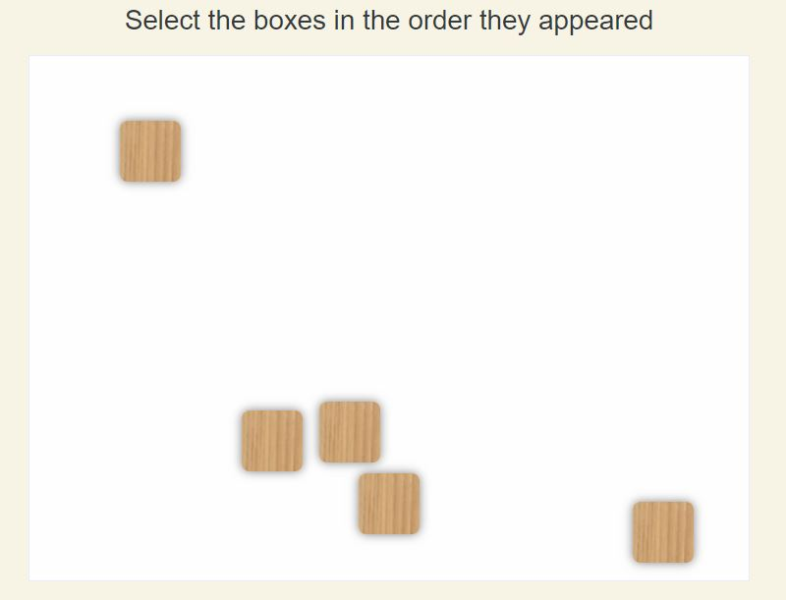

Slide 14
Materials and Methods
3. Outcome Measurements
(7) Regensburg Word Fluency Test (RWT) for executive functions as phonematic verbal fluency and cognitive flexibility: Generate as many words as possible in 1 min beginning with predefined or changing initial letters.
(8) Bergen Right-Left Discrimination Test (BRLD) for visual-spatial abilities
(a) BRLD-A
(b) BRLD-B

Slide 15
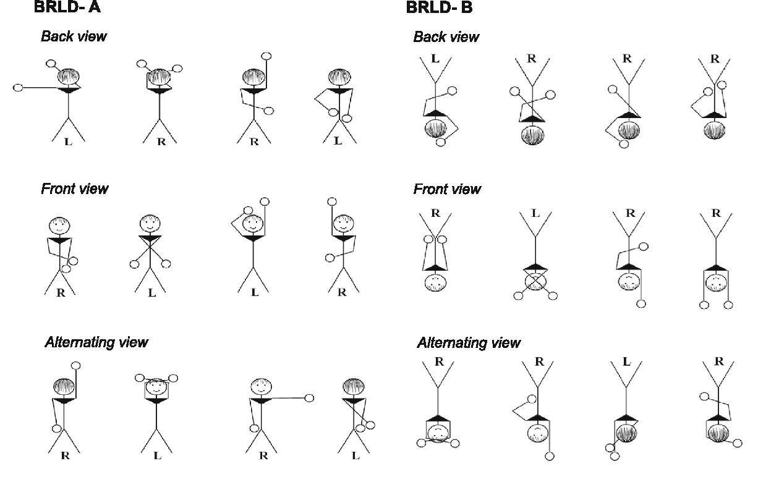

Slide 16
Materials and Methods
3. Outcome Measurements
(9) Memory Assessment Clinics Questionnaire (MAC-Q) for subjective memory complaints (主观记忆减退).
(10) Beck Depression Inventory (BDI-II) for severity of depressive symptoms.

Slide 17
Results
1. Stroke patients with hemi- or quadrantanopia showed a significantly lower free verbal recall than healthy controls at the first learning trial. Both groups increased their performance across the course of the training.
2. The same pattern of results was evident for the amount of correctly purchased products in the VR supermarket.
3. Regarding walking distance in the supermarket, analyses revealed a significant decrease across the learning trials in the healthy controls. There was no significant group differences at the first and the last training trial.
4. A significant reduction in shopping time across the learning trials was observed in healthy controls. In general, healthy controls required significantly lower shopping times.

Slide 18
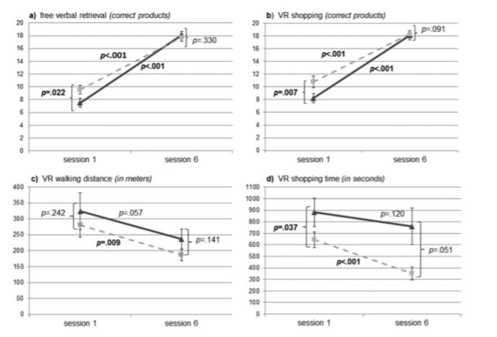

Slide 19
Results
5. The patients group showed significantly improved visual memory retrieval performances after the training.
6. Both groups showed a lower severity of depressive symptoms after than before training with healthy controls showing less symptoms than stroke patients with hemi- or quadrantanopia.

Slide 20
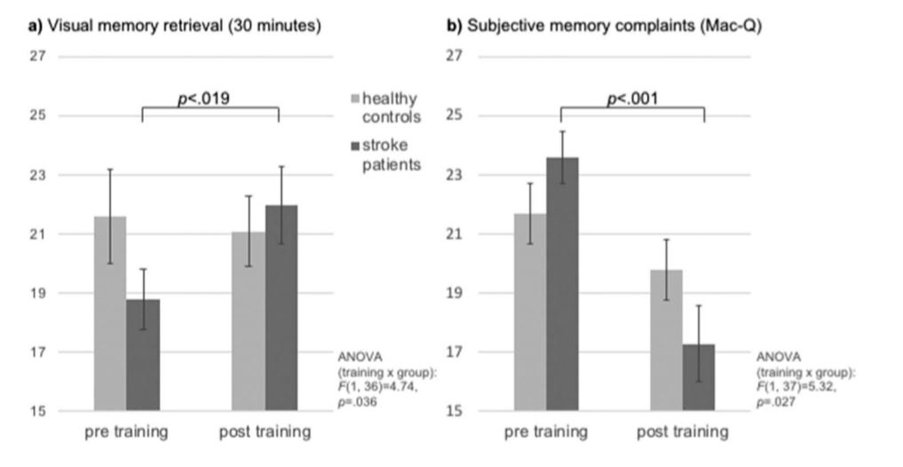

Slide 21
Limitations
1. No control group for stroke patients.
2. Unequal sex distribution.
3. A quantification of visual field defects could have allowed more valid conclusions about possible training effects on visual field recovery.

Slide 22
Conclusion
1. Our study introduces an interesting novel treatment approach to improve cognitive functions relevant to daily life in stroke patients with visual field defects.
2. VR training can improve particularly visual-spatial skills in patients with hemianopia or quadrantanopia.

